Slide 1
Tutorial-2
Division 3
December 22, 2021

Slide 2
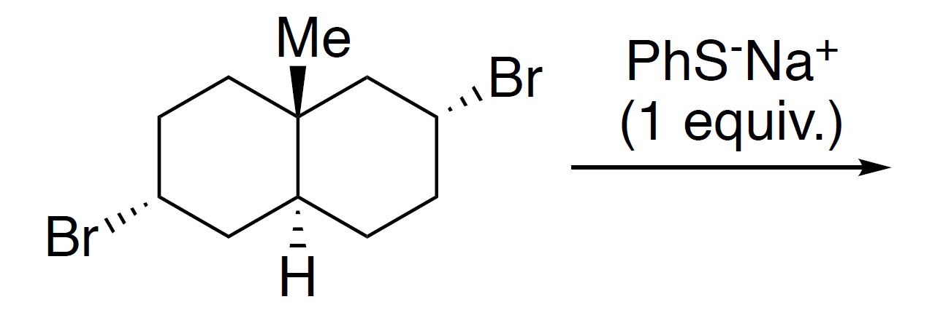
1. Predict the major product of the following reaction with correct stereochemistry and rationalize the outcome. Your explanation should contain appropriate conformational diagrams.

Slide 3
1 mark
1 mark

Slide 4
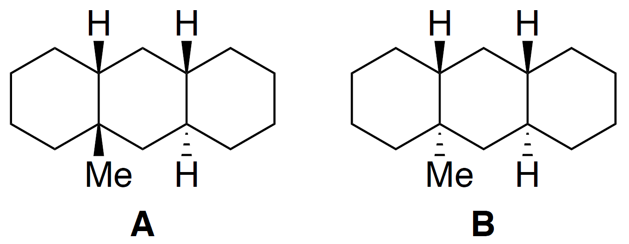
2. Write the most stable conformer of the following molecules A and B. Calculate the gauche interactions in each and find the difference in their energy.
Eclipsing interactions:
H/H = 1 kcal/mol
H/Me = 1.3 kcal/mol
Me/Me gauche interaction = 0.9 kcal/mol

Slide 5
4- Gauche Interaction
4 x 0.9 = 3.6 kcal/mol

Slide 6
Same interaction
5- Gauche Interaction
5 x 0.9 = 4.5 kcal/mol
Difference = 4.5 - 3.6
= 0.9 kcal/mol

Slide 7
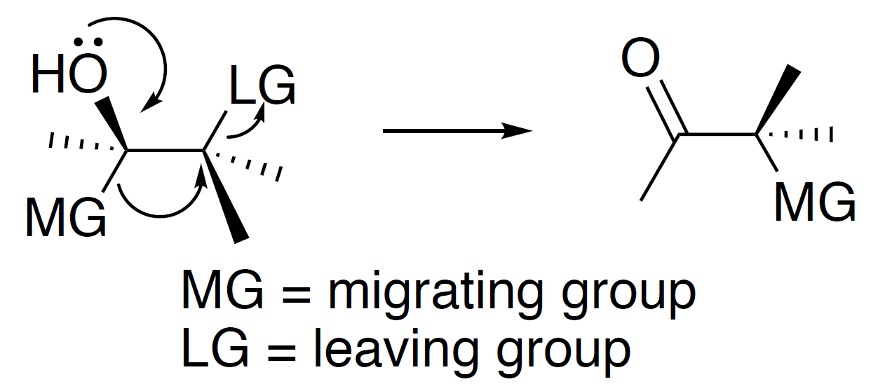
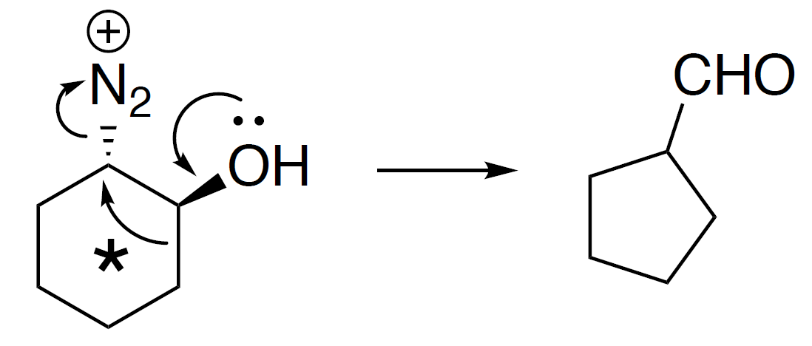
4. Given below is an example of a rearrangement reaction.
For the following reaction, identify the MO interactions involved for the arrow marked ‘*’ in the migration step using appropriate conformational drawing.

Slide 8
Trans-diequatorial conformation → has proper overlap of MOs (proper overlap)
(σ_{C-C})² → (σ*_{C-N2})⁰ in diequatorial conformation
Trans-diaxial conformation → do not have proper overlap of MOs (σ_{C-C} and σ*_{C-N2} are not proper)

Slide 9
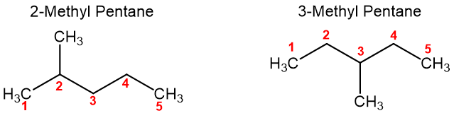
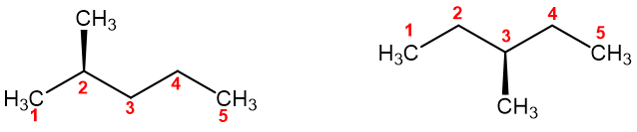
5. Draw the Newman projection of the most stable conformers of
a. 2-methylpentane
b. 3- methylpentane
Calculate the energy difference between them.

Slide 10
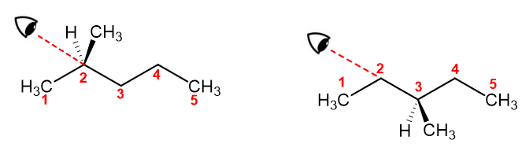
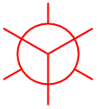
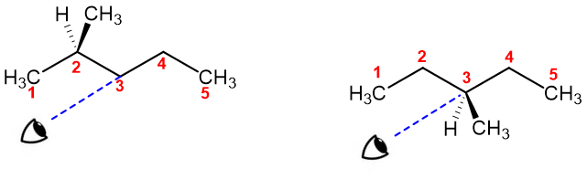
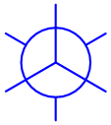

Slide 11
Most Stable
One gauche interaction
One gauche interaction
Most Stable
Anti conformation – No gauche interaction
Conclusion: 2-Methyl pentane – one gauche interaction (0.9 kcal/mol)

Slide 12
Most Stable
(Me and Et anti)
(Me and Me anti)
Plane of Symmetry
in a molecule
Most Stable
(Me and Et anti)
Conclusion: 3-Methyl pentane – two gauche interaction (1.8 kcal/mol)

Slide 13
Value For one Gauche interaction
Value For one Gauche interaction
0.9
1.1
0.9
2.5

Slide 14
2-Methyl pentane
one gauche interaction
0.9 kcal/mol
3-Methyl pentane
two gauche interaction
1.8 kcal/mol
So, the energy difference between them = 0.9 kcal/mol

Slide 15
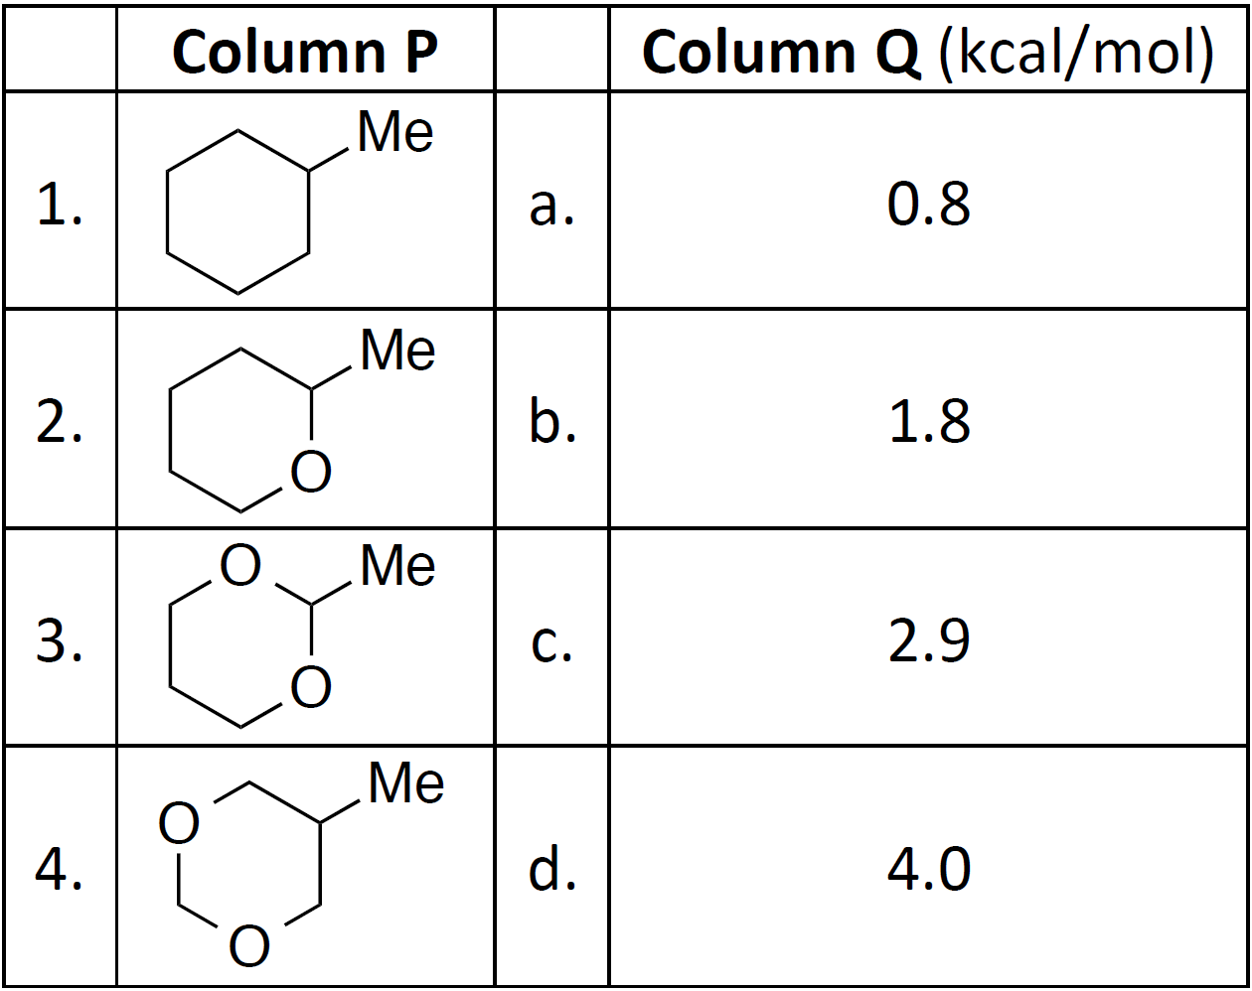
6. Match the structures in Column P with the ‘A values’ in Column Q. (*Take home problem)

Slide 16
Kcal/mol
0.9
0.9
1.8
0.9
2.0
2.9
2.0
2.0
4.0
0.4
0.4
0.8

Slide 17
